Slide 1



Arduino 2 – alarm
Steven hammer
s.hammer@hw.ac.uk

Slide 2
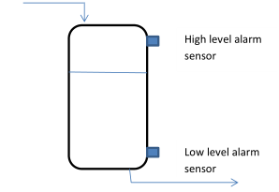
introduction
Using an Arduino to sense a (simulated) water level in a liquid storage tank
Light the high level LED if the tank level is high
Light the low level LED if the tank level is low

Slide 3
What are we doing today?
Add buttons to the blink circuit
Add another LED
Use conditional statements in code e.g.
Make the high level or low level LED turn on

Slide 4
What are we doing today?
Two tasks in total:
High/low indicators with two LEDs and two push buttons
Green/yellow/red LEDs to indicate different levels

Slide 5
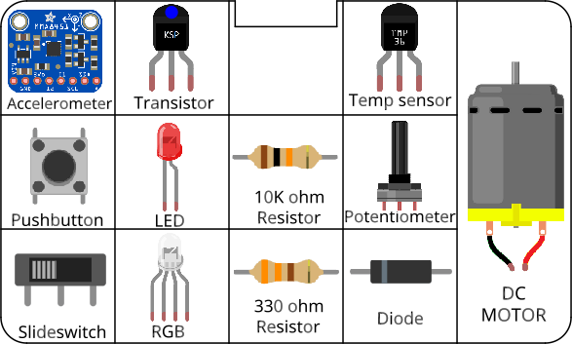
Circuits
All components included in the kit…

Slide 6
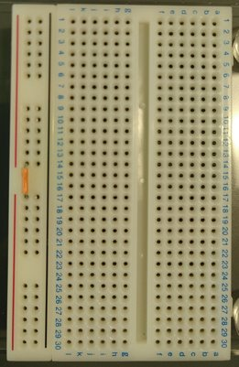
Before you start Building circuits…
Connect power bus (+ line) together using a small section of jumper cable

Slide 7
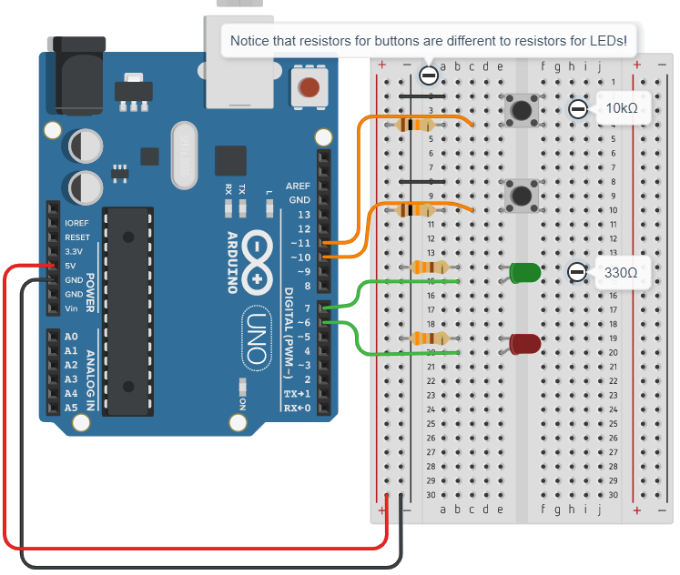
Building circuits
Insert components into breadboard holes
Connect up using instrument wire
Arduino controls inputs and outputs
Follow schematics
NOTE: GND = negative

Slide 8
Debugging code
Is there a space missing somewhere?
Do all lines end with a semicolon;
Is something commented out //

Slide 9
housekeeping
Take two boxes:
One Arduino box
One Sensors and Motion kit
Put components back into labelled places in boxes after use
Any components missing – let us know.

Slide 10
TIDYING up
Return components to your Sensors and Motion box IN THE CORRECT PLACES!!!
Put instrument wire in motor compartment
Return Arduino to its case
Return both boxes to tutor

Slide 11
Finished already?
Try the RGB LED tutorial (on VISION)
Replace the three coloured LEDs in task 2 with a single RGB LED that shines red, yellow or green depending on liquid level

